Slide 1

Welcome to Year 6
Meet the teacher session

Slide 2
Welcome
Our Ethos and Values
The Year 6 staff team
Weekly timetable
Expectations in Year 6
Assessments
How you can help at home
Other information
Questions

Slide 3

As an Educate Together school:
We are an equality-based school where we live by the motto: ‘learn together to live together’.

Slide 4
As an Educate Together school:
We value all children and the unique contribution that they offer to the school.
We believe that all children learn best when they feel safe and are happy in school.
We believe that respect underpins all of our relationships within school and with the outside world.
We ensure that all pupils achieve their fullest potential and are fully prepared for the next stage of learning and life.

Slide 5
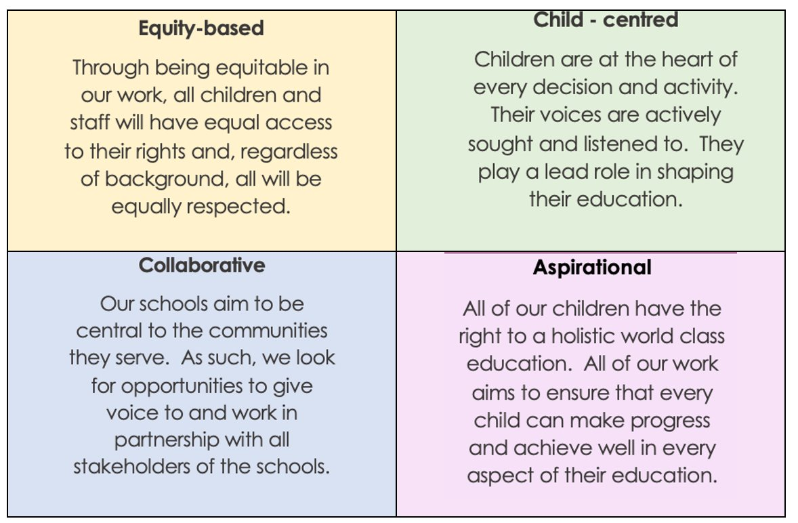
Our Four Core Principles:

Slide 6

Our School Rules
Behaviour is communication and our job as educators is to seek to understand what a child is telling us and support them. Only when children behave in appropriate ways can they achieve their best.
Consistent, clear, and firm boundaries are key to promoting positive learning behaviours.

Slide 7

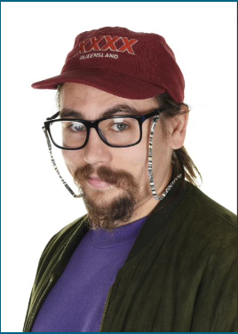
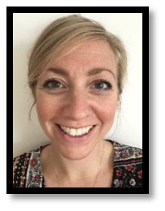
The Year 6 Staff Team
Hana and Laurie – Class Teachers
Paul – Learning Support Assistant
Mike/Gemma – Cover Teacher (Monday pm)
Lisa – covering Okapis Friday
Paul
Laurie - Bonobo
Hana and Lisa - Okapi

Slide 8
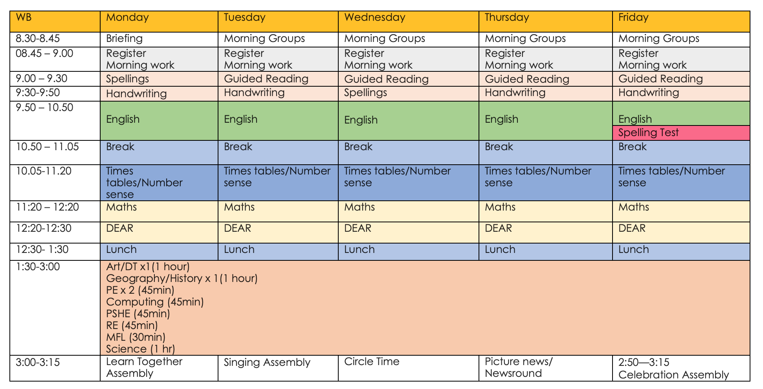
Example of weekly timetable
Examples saved in timetable folder for Lower/upper school (Please note y3 next year you will be upper school)

Slide 9

At RET we use a whole-school THRIVE Approach, which means we prioritise every child's social and emotional development alongside their learning.
It helps children and young people become more emotionally resilient and better placed to engage with life and learning.
We do this through our whole-school approach to wellbeing.

Slide 10
Expectations in Year 6
Children take responsibility for their environment and learning.
Children model exemplary behaviors for others in school.
Children will continue to take ownership of their learning, with some support from the class teacher.
Children will continue to edit and improve their work.
Children develop fluency in the ‘basics’ in certain lessons such as cursive handwriting, accurate punctuation, recalling times tables facts etc.

Slide 11
Assessments
Year 6 pupils will still be assessed each term (as other year groups are) on:
  Reading
  Spelling, Grammar and Punctuation
  Maths (Arithmetic and Reasoning)
  Writing
  SATS will be in Term 5

Slide 12
You can help at home with…
Online platform – share what you are up to at home, making links with our curriculum topic learning.
We use Times Table Rockstar, Accelerated Reader etc. Spelling Shed
Read emails and messages shared on Class Dojo

Slide 13
You can help at home with…
Reading – books set on Accelerated Reader and other books, magazines etc.
  Encouraging them to use their phonics knowledge to read unfamiliar words.
  Asking your child questions about what they have read.
  Encouraging them to use the text to discuss and work out the meaning of unknown words.
  Discussing the sequence of events in books.
  Getting your child to re-read books to build up their fluency.

Slide 14


Slide 15
You can help at home with…
Maths – practising key skills
  Rounding any whole number to a required degree of accuracy
  Use negative numbers in context and calculate intervals across zero
  Solve addition and subtraction multi-step problems in contexts, deciding which operations and methods to use and why
  Multiply multi-digit numbers up to 4-digits by a two-digit whole number
  Divide numbers up to 4 digits by a two-digit number and interpret remainders, fractions, or by rounding, as appropriate for the context
  Recall and use equivalences between fractions, decimals and percentages including in different contexts
  Use, read, write and convert between standard units, converting measurements of length, mass, volume and time from a smaller to a larger unit, and vice versa, using decimal notation to up to 3 decimal places

Slide 16
You can help at home with…
Writing – writing for purposes at home e.g. letters, diary, own stories.
In narratives, describe settings, characters and atmosphere
Integrate dialogue in narratives to convey character and advance the action
Use verb tenses consistently and correctly throughout their writing
Spell correctly most words from the year 5 / year 6 spelling list and use a dictionary to check the spelling of uncommon or more ambitious vocabulary
Use paragraphs to organise ideas

Slide 17
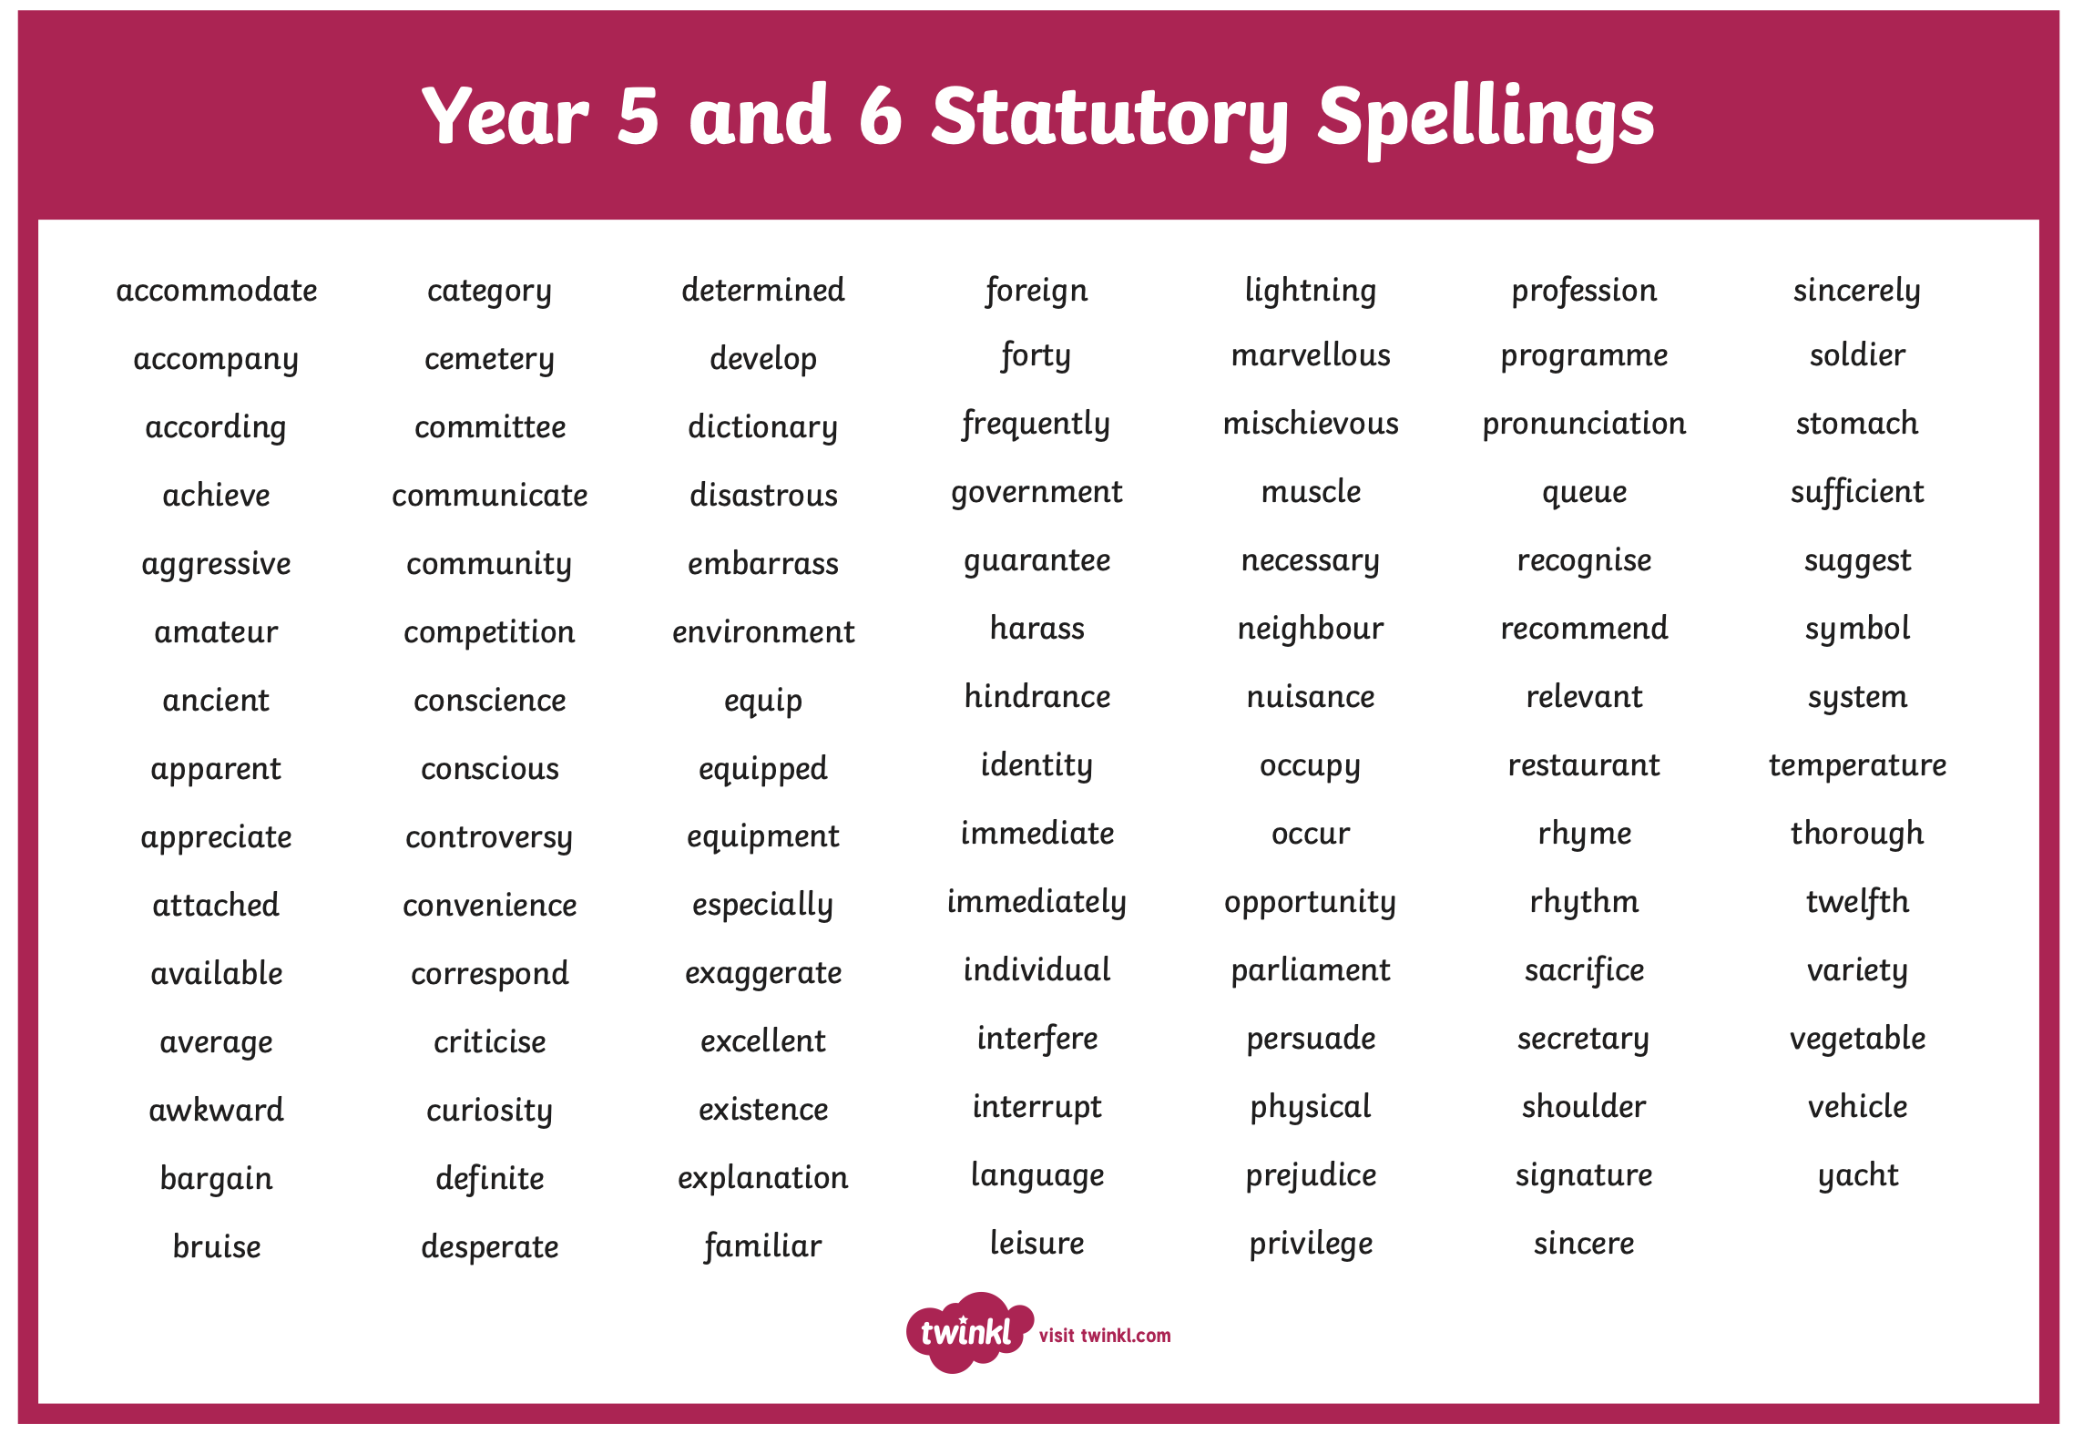
Spellings

Slide 18
You can help at home with…
The wider curriculum
Discuss topics being studied with your child – ask them about their learning.
Supporting your child with researching on the internet or using books to find out more facts about a topic or subject.
Sharing your own passions, interests or skills with your child to enhance their learning.

Slide 19
Other information
PE days will be set at the start of the year. Please ensure that your child comes to school in PE clothes and trainers on these days, once specified.
Book bags, reading books and reading records are to be brought in daily. Children can choose to change their reading book as and when they have finished it and have a comment/comments in their reading record from an adult to say that they have read and finished it/reread it for fluency.
We go out for Daily Mile and break times in all weathers, please ensure children come to school with suitable clothing – a waterproof coat with a hood is advised
You will be invited to a Parent Evening meeting in October

Slide 20
Educate Together Clothing Guidelines
At Redfield Educate Together, we encourage children to express themselves and feel comfortable being who they are. While we don’t have a school uniform, we ask that clothing follows a few important guidelines to keep everyone safe, comfortable, and included.
📱 Technology and Toys
Toys, cards and fidgets must not be brought to school
Year 5 & 6 children who walk to or from school independently may bring a mobile phone.
➤ Phones must be handed to a staff member at the start of the day.
Smart watches should not be worn to school.
➤ If worn, they must be handed in at the start of the day.
Phones and smart watches must not be used on school site.
✅ Clothing should be:
Comfortable and weather-appropriate​
Easy for children to manage independently​
Suitable for movement and active play​
Respectful of everyone in our school community​
❌ We do not allow:​
Clothing that restricts movement (e.g., skinny jeans)​
Unsafe footwear (e.g. open-toe sandals, backless shoes)
Jewellery that could cause injury (e.g. necklaces, hoop earrings)​
Make-up or false nails​
Crop tops or clothing with unkind/offensive messages

Slide 21
Each day children should come to school with…
A named water bottle (water only, no squash)
Bookbag & reading book
Suitable coat for breaktimes
Suitable shoes for active play and PE

Slide 22
