Slide 1
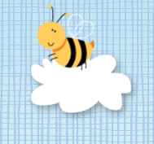
Tapestry
Workshop
Parents & Carers | Tapestry

Slide 2
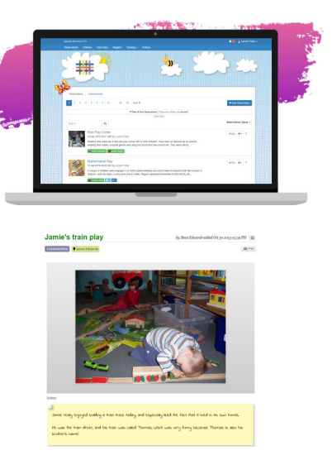
What is Tapestry?
Tapestry is an online journal. It is a way to collect photos, videos and observations – to share information about what your child is learning.
It can be accessed through the website or you can download an app on phones or tablets.
You can view and add observations easily using the app.

Slide 3
What happens on Tapestry at your child’s setting?
Staff will be adding observations about the children during the week.
They will be looking to record moments when your child shows them new learning.
Tapestry helps staff to know where your child is working developmentally and can plan/action the next learning steps for them.
Staff may also simply take a phone or video to capture the ‘wow moment’.

Slide 4
Expectations
Numbers of observations will vary. We also collect evidence in other ways and want the majority of our time to be interacting with your child – not staring at iPads!
Your child will not have an observation everyday – this does not mean they haven’t been learning.
Observations will have the area of learning codes as titles – these help us keep track of evidence. E.g., C&L = communication and language
The photos on Tapestry are to remain as online files. They cannot be screenshotted/copied/shared. This maintains the safety of the online journals.

Slide 5
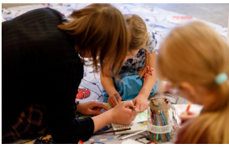
Observations
As the title, observations will have codes for the main area on learning that it covers.
There will be a brief description of what has been observed.
Adult intervention will be denoted with a ‘T’ – this will show how they have dug a little deeper into the child’s understanding and gained more knowledge for assessment taken of the learning in the moment.

Slide 6
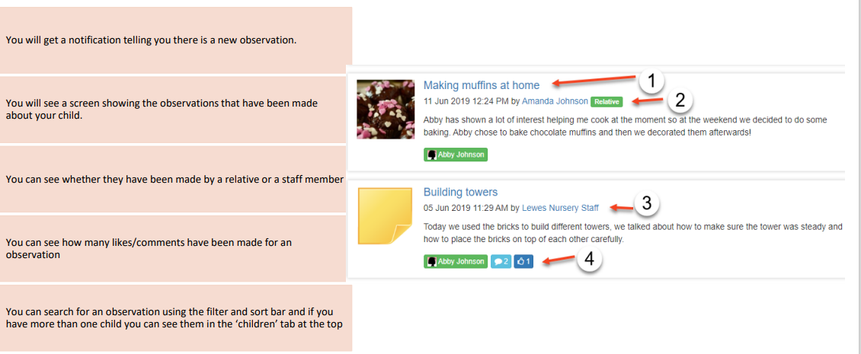

Slide 7
Adding your own observation
This is a great way to engage with your child’s learning!
What kind of things can you add?
- A photo and a note about mini outings e.g., going on the bus
- A family celebration
- Everyday experienced you have built together e.g., cooking, reading, gardening, jumping in puddles
- Any new learning you see happening e.g., using scissors, counting, kicking a ball, making connections

Slide 8
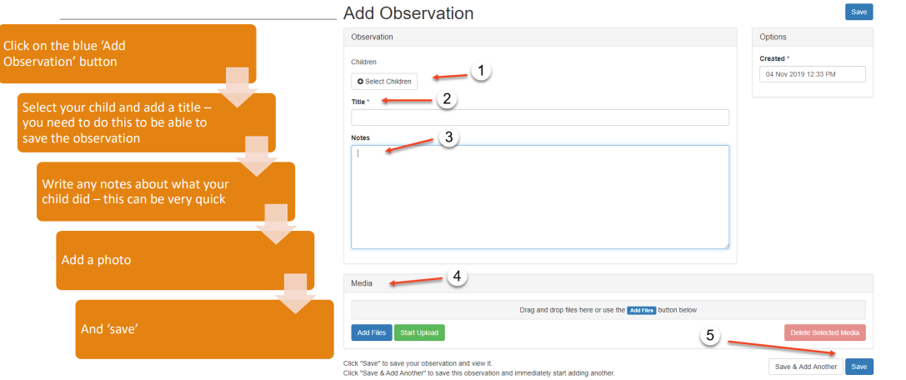

Slide 9
How does adding observations yourself help your child?
Every time you add an observation, you tell us a bit more about your child!
Staff will know to ask your child about the family visit, trip to the park or visit to aunties. This helps your child feel remembered and special.
Staff can help your child make connections e.g., when your child is making cakes with the playdough, the adult can chat with them about the cooking they already know your child did at home.

Slide 10
How is the data kept safe?
A password is required to access Tapestry, remember the stronger the password you set, the more secure your account is.
You are linked manually to your child/children so you can only view observations for them you
We don’t need to store any of the data entered onto Tapestry
Data is stored separately for each school
Tapestry’s developers and support personnel require our permission to access our Tapestry account
For more information about Tapestry security you can go on their website https://tapestry.info/security.html

Slide 11
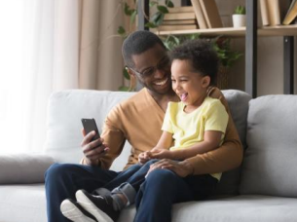
Sharing Tapestry with your child
Spend time looking at the photos that have been added by you or by the school staff and ask your child about them.
This is an important way to engage with your child’s learning and supports their vocabulary and language development.

