Slide 1
When my teacher is away

Slide 2
My name is ___ I am _____ years old I go to Redfield Educate Together Primary School. My teacher is called Anna. She helps me with my work
Photo of teacher goes here. Can save and add a photo from school website.

Slide 3
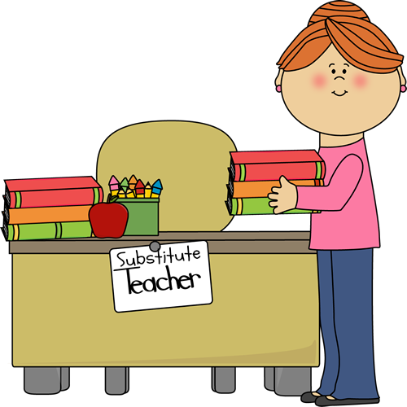
Sometimes Anna might not be at school. This could be for different reasons. Two examples are… She might not be feeling very well. She might have to go to an appointment. When this happens we have a Champion teacher and this is ok.
A different teacher…

Slide 4
The Champion teacher is there to teach us. The Champion teacher is there to help us. My friends and other people I know at school will also still be there to help me.
The Champion teacher will help me

Slide 5
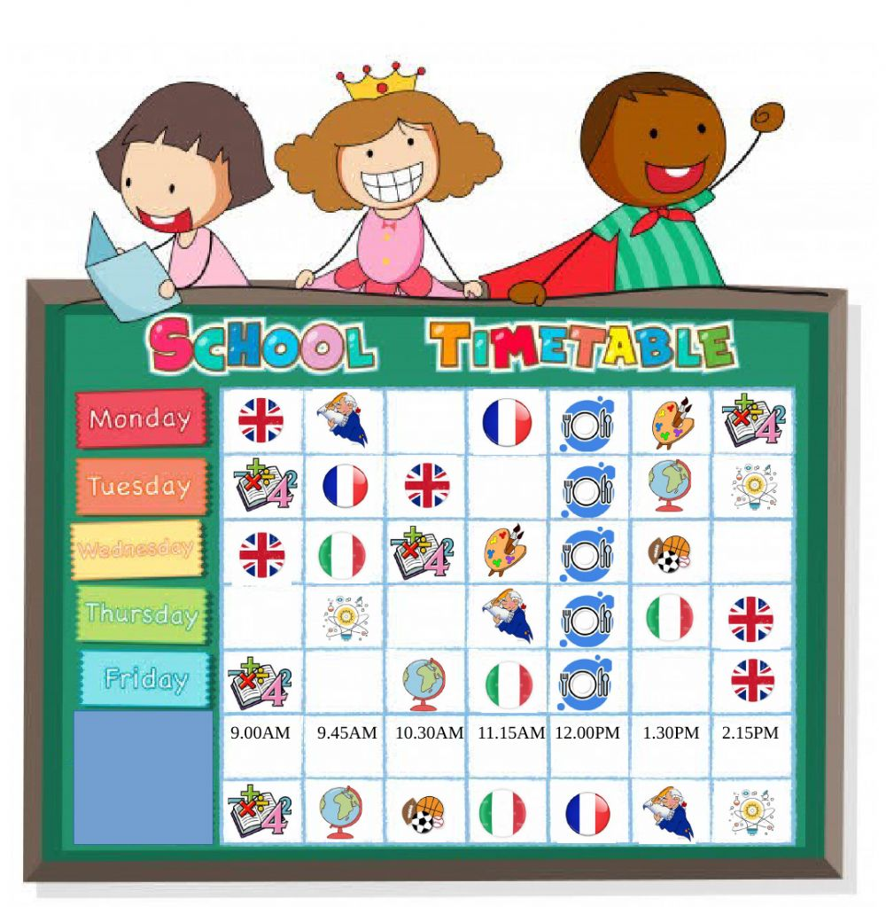
We will still have a timetable with activities for the day. We will do learning activities that are similar to the ones I do with _____ They might seem a little different with a different teacher but this is ok. The school day will still start and finish at the same time. We will still have break and lunch at the same time
Timetable

Slide 6
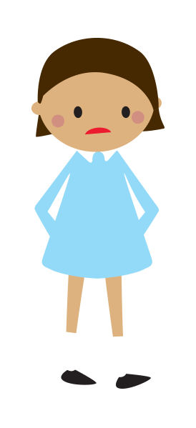
Sometimes I might feel worried about having a new teacher. They don’t know my name. They might do things a little different from our normal teacher.
Sometimes I can be worried

Slide 7
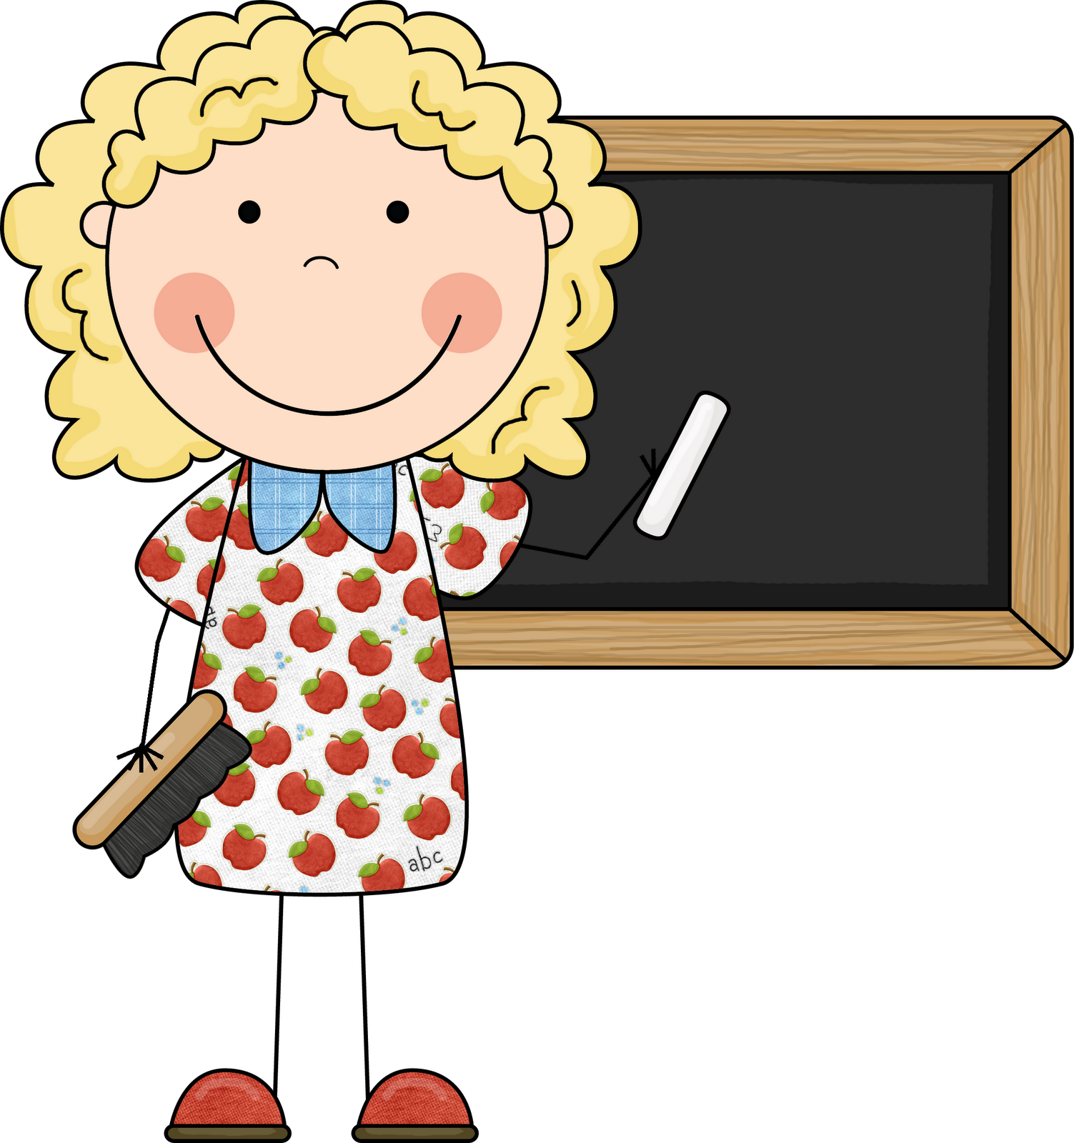
It’s ok to feel worried when there is a new teacher that I don’t know. There are things I can do to feel better…
There are things I can do to feel better

Slide 8
My list of things I can do to feel better... I can introduce myself I can get to know them by asking something about them I can…. I can….
There are things I can do to feel better

Slide 9
The teacher might be worried too. They might need some help. Here is my list of things we could do to help the teacher… We can tell them where to find things in the classroom We can tell them where we got to with our work yesterday We can…
There are things I can do to help the teacher

Slide 10
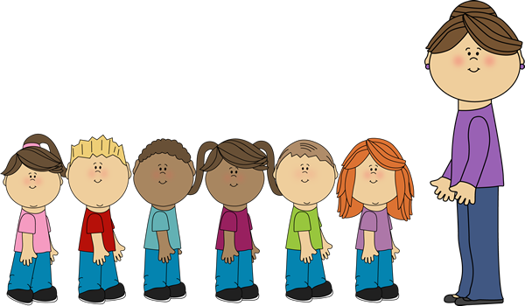
When there is a Champion teacher, it will be ok. The Champion teacher will help me and I can help the Champion teacher. I can still do my work and follow the Redfield way My teacher will be back at school again soon.
All will be ok

