Slide 1

Welcome to Year 4
Meet the teacher session
^{Tuesday 8th July 2025}
3:30pm – 4:00pm

Slide 2
Welcome
Our Ethos and Values
The Year 4 staff team
Weekly timetable
Expectations in Year 4
Assessments
How you can help at home
Other information
Questions

Slide 3

As an Educate Together school:
We are an equality-based school where we live by the mottos: ‘no child an outsider’ and ‘learn together to live together’.

Slide 4
As an Educate Together school:
We value all children and the unique contribution that they offer to the school.
We believe that all children learn best when they feel safe and are happy in school.
We believe that respect underpins all of our relationships within school and with the outside world.
We ensure that all pupils achieve their fullest potential and are fully prepared for the next stage of learning and life.

Slide 5

Our Four Core Principles:

Slide 6

Our School Rules
Behaviour is communication and our job as educators is to seek to understand what a child is telling us and support them. Only when children behave in appropriate ways can they achieve their best.
Consistent, clear, and firm boundaries are key to promoting positive learning behaviours.

Slide 7

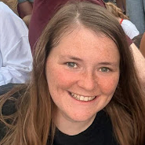
The Year 4 Staff Team
Katie-Beth–Class Teacher in Rhinos (Thursdays – Lisa Term 3 onwards Emma)
Richenda-Class Teacher in Narwhals
There will be a Year 4 learning support assistant. Staff are still being allocated at the moment. This is still TBC.
PPA cover teacher- we have HLTA’s in school it is likely that one of these teachers will cover our PPA and other additional management time.
* Mike and Radha will be covering PPA from Term 3.

Slide 8
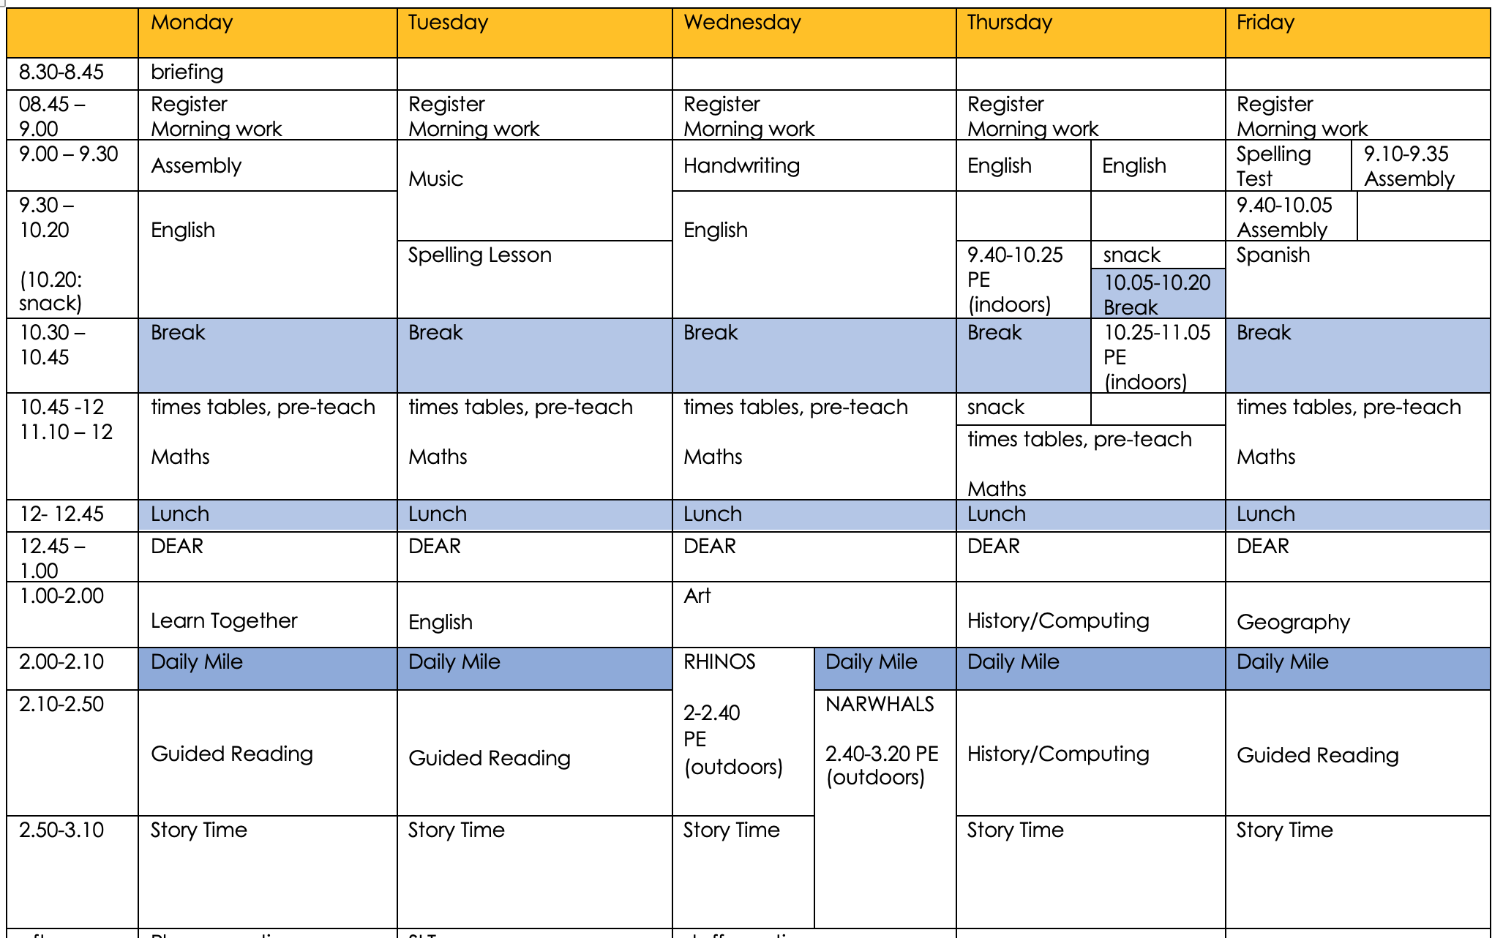
Example of weekly timetable

Slide 9
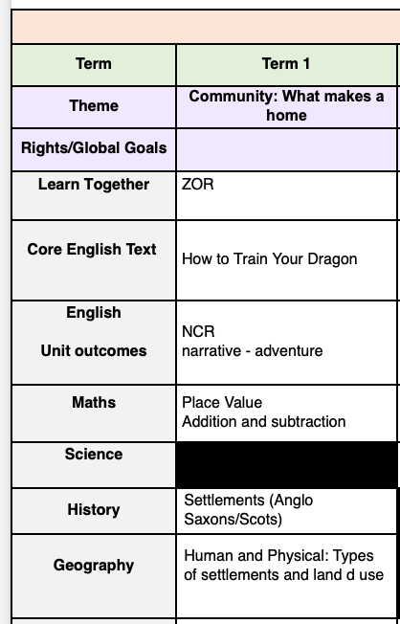
Term 1

Slide 10

Thrive offers a whole-setting approach to supporting the right-time social and emotional development of all children and young people.
It helps children and young people become more emotionally resilient and better placed to engage with life and learning.
We do this through our whole-school approach to wellbeing.

Slide 11
Expectations in Year 4
Children are focused and ready for learning after each transition.
Children self-mark work in maths and edit and improve their written work.
Children are expected to follow our ETWW rules in all written work, showing basic punctuation, neat handwriting, moving to a consistent cursive style when ready and plausible attempts at spelling.
Children are expected to follow presentation guidelines in maths to show pride in their work and to organise their working out, using one digit per box to set out calculations correctly.
Children are expected to show further independence in their learning.
At home:
Children are expected to read at home 5x per week and record their reading in a home reading journal. We will check journals weekly. They should be in school bags everyday. We encourage children to read for pleasure and explore their interest of a wide range of genres and text types. At school children will have an ‘AR’ book which is a levelled book based on a reading level range, from our Accelerated Reader assessments. Children will take quizzes when the books are completed to check their comprehension. The pass marks encourage children to choose books within their reading range, increasing in difficulty, as they progress through the quizzes. Children will also be allowed to take a ‘reading interest book’ from the school library weekly. We have a wide range of books, both fiction and non-fiction, which children are allowed to read based on their own interests/curiosities.
Children are expected to complete one session of TTRS, set by the teacher weekly. (This will usually be started in weekly computing sessions and completed at home.
Children are expected to practice their spellings at home ready for a weekly test.

Slide 12

Assessments
To inform the teachers' planning cycle, Year 4 pupils will still be assessed each term (as other year groups are) on:
  Reading
  Spelling, Grammar and Punctuation
  Maths (Arithmetic and Reasoning)
  Writing
  Year 4 also partake in the National Times Table Test in the summer term. Results will be shared at the end of the school year. Weekly TTRS will be held weekly in school, we start with the Garage game which is great for heatmaps and practice, progressing on to the timed soundcheck games which have 6 seconds per questions, and also closely mimics the MTC.

Slide 13
You can help at home with…
Check that you are receiving messages on class dojo.
Online platform – share what you are up to at home, making links with our curriculum topic learning. In year 4 we encourage show and tell for home learning or achievements.
Read emails and messages shared on Class Dojo
Reading
Writing
Maths
Spelling

Slide 14
You can help at home with…
Reading – books set on Accelerated Reader and other books, magazines etc.
  Encouraging them to use their phonics knowledge to read unfamiliar words.
  Asking your child questions about what they have read.
  Encouraging them to use the text to discuss and work out the meaning of unknown words.
  Discussing the sequence of events in books.
  Getting your child to re-read books to build up their fluency.
  Encouraging your children to read for pleasure and explore interest in a range of genres and text type.

Slide 15


Slide 16
You can help at home with…
Maths – practising key skills – this could be verbally or practically when out and about or at home.
  4 digit column addition and subtraction
  2 and 3 digit by 1 digit short multiplication
  Multiplication and related division facts up to 12 x 12.
  Dividing a 1 or 2 digit number by 10 or 100
  Read the time on analogue and digital clocks (12 and 24 hour)
  TTRS. Times Table Rockstars is an amazing tool. Weekly sessions will be set in class to be completed at home.

Slide 17
You can help at home with…
Writing – writing for purposes at home e.g. thank you cards, letters, shopping lists, diary, own stories.
  Encouraging your child make plausible attempts at unknown words.
  Spelling words from the statutory Year 3 and 4 spelling list correctly.
  Forming letters correctly and joining letters when handwriting.
  Punctuating sentences correctly. Capital letters and full stops are the basics.
  Discussing the use of capital letters for sentence starts, people, and places.

Slide 18


Slide 19
You can help at home with…
Spelling
Weekly spellings sent home quiz on Friday
Discussing the meanings of words and using them in contexts.
Learning spellings and engaging with spellings in creative ways to commit them to the long-term memory.
Spelling Shed

Slide 20
You can help at home with…
The wider curriculum
Discuss topics being studied with your child – ask them about their learning.
Supporting your child with researching on the internet or using books to find out more facts about a topic or subject.
Sharing your own passions, interests or skills with your child to enhance their learning.

Slide 21
Other information
PE days this term are ________________TBC outdoors. Please ensure that your child comes to school in PE clothes and trainers on these days.
Book bags, reading books and reading records are to be brought in daily. Children can choose to change their reading book as and when they have finished it and have a comment/comments in their reading record from an adult to say that they have read and finished it/reread it for fluency.
We go out at break times in all weathers, please ensure children come to school with suitable clothing – a waterproof coat with a hood is advised.
You will be invited to a Parent Evening meeting in October.

Slide 22
Each day children should come to school with…
A named water bottle
Bookbag & reading book
Suitable coat for breaktimes
Suitable shoes for active play and PE.
Children in Year 4 are provided with stationary pens/pencil and rules.
There is no need for children in year 4 to bring in stationary, toys from home. nor any fidget toys.

Slide 23
Over the course of the year if you have any questions, please send in an email to the office, send a message on ClassDojo or catch us after school one day!
We aim to reply to emails and Class Dojo messages within three working days.

