Slide 1

Welcome to Year 6
Meet the teacher session
^{Monday 7th July 2025}
3:30pm – 4:00pm

Slide 2
Welcome
Our Ethos and Values
The Year 6 staff team
Weekly timetable
Expectations in Year 6
Assessments
How you can help at home
Other information
Questions

Slide 3

As an Educate Together school:
We are an equality-based school where we live by the mottos: ‘no child an outsider’ and ‘learn together to live together’.

Slide 4
As an Educate Together school:
We value all children and the unique contribution that they offer to the school.
We believe that all children learn best when they feel safe and are happy in school.
We believe that respect underpins all of our relationships within school and with the outside world.
We ensure that all pupils achieve their fullest potential and are fully prepared for the next stage of learning and life.

Slide 5
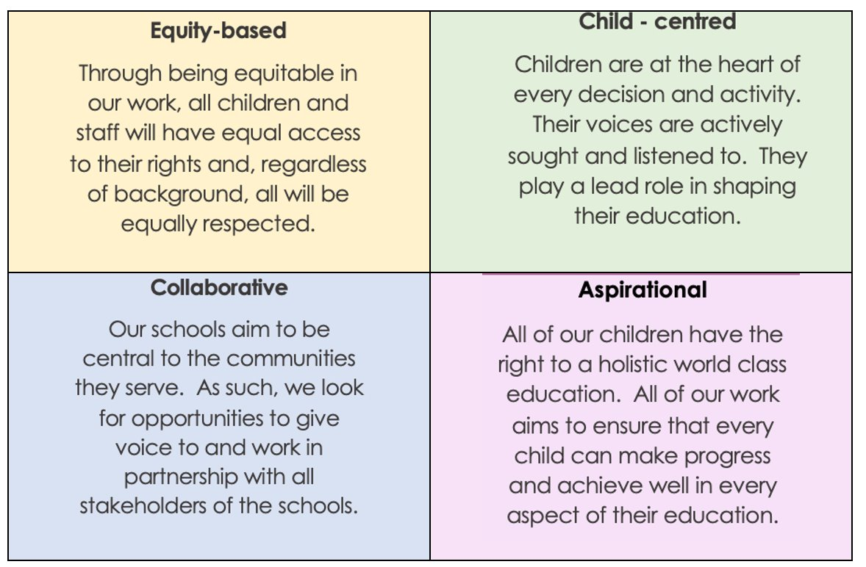
Our Four Core Principles:

Slide 6

Our School Rules
Behaviour is communication and our job as educators is to seek to understand what a child is telling us and support them. Only when children behave in appropriate ways can they achieve their best.
Consistent, clear, and firm boundaries are key to promoting positive learning behaviours.

Slide 7
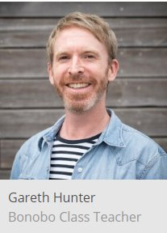
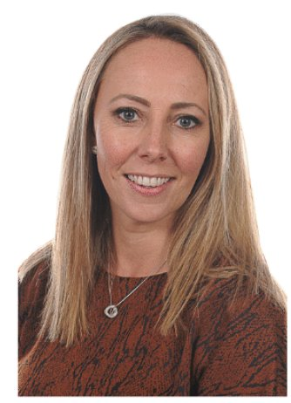
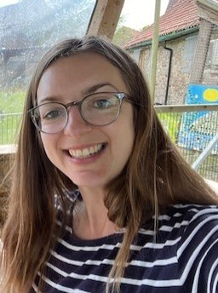
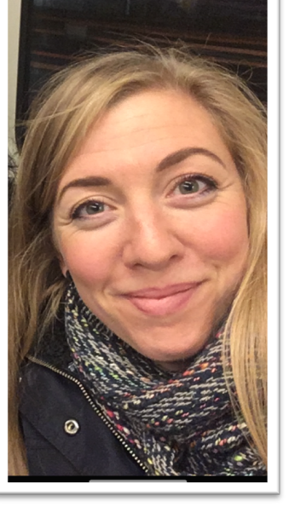
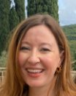
The Year 6 Staff Team
Bonobo class
Gareth – Class Teacher (Mon-Thurs)
Lisa – Deputy Head (Fri)
Okapi class
Natalie – Class Teacher (Term 1, Mon-Tues)
Laurie – Class Teacher (Term 1, Weds-Fri; Term 2 onwards, Fri)
Hana – Class Teacher (Term 2 onwards, Mon-Thurs)

Slide 8
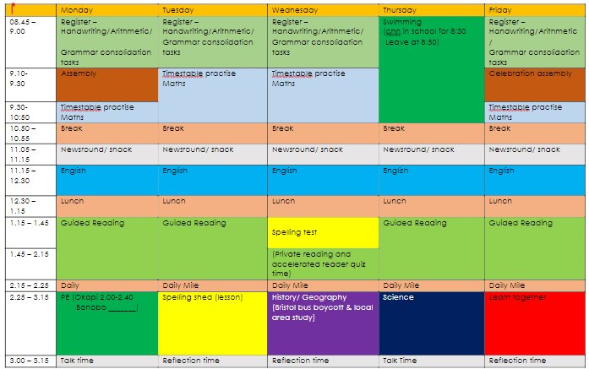
Example of weekly timetable

Slide 9
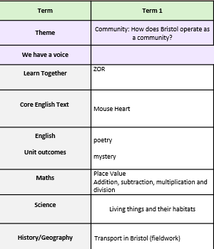
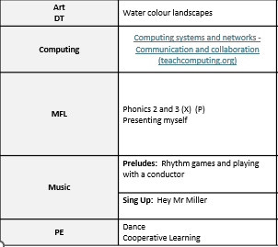
Term 1 topics

Slide 10

Thrive offers a whole-setting approach to supporting the right-time social and emotional development of all children and young people.
It helps children and young people become more emotionally resilient and better placed to engage with life and learning.
We do this through our whole-school approach to wellbeing.

Slide 11
Expectations in Year 6
Children take responsibility for their environment and learning.
Children will continue to become more independent in completing learning set, with support from the class teacher and LSW’s.
Children will edit and improve their work based on feedback from class teacher.
Children knowing and recalling the ‘basics’ in lessons such as use of capital letters, punctuating sentences accurately, recalling times table facts etc.
Children to remember their PE kits and swimming kit (Thursdays).
Children will be set weekly homework from Term 2.
If your child is invited to a morning or afternoon booster group, it is essential that children attend to have the greatest impact to their learning and preparation for Year 7.
End of Key Stage 2 – Preparing the children for transition to Key Stage 3.

Slide 12
Each day children should come to school with…
A named water bottle
Bookbag & reading book
Suitable coat for breaktimes
Suitable shoes for active play and PE
Optional healthy morning snack
Children are provided with stationery.
There is no need for children to bring in any items from home, such as pencil cases, toys, fidgets etc.

Slide 13
Assessments
Year 6 pupils will be assessed each term (as other year groups are) on:
  Reading
  Spelling, Grammar and Punctuation
  Maths (Arithmetic and Reasoning)
  Writing (This will be a continual assessment from each piece of writing the children complete throughout Year 6)
  These termly assessments will culminate in the SATs assessments, taking place over the week commencing 11th May 2026.

Slide 14
You can help at home with…
Reading – books selected from school that can be recorded and assessed for understanding on Accelerated Reader. Please note any books that you read at home may also be recorded on Accelerated reader to contribute to your child’s progress.
  Encouraging them to use their phonics knowledge to read unfamiliar words.
  Asking your child questions about what they have read. Please see the next slide for some helpful question stems.
  Encouraging them to use the text to discuss and work out the meaning of unknown words.
  Discussing the sequence of events in books.

Slide 15
You can help at home with…
Maths – practising key skills – this could be verbally or practically when out and about or at home.
  Recalling multiplication tables (2s to 12s) and the related division facts – You can use Timestable Rockstars to support this.
  Mental methods of addition, subtraction, multiplication and division.
  Written methods of addition, subtraction, multiplication and division.
  Calculating time for different events throughout the day (e.g. if the film is 90mins what time will it finish if we start watching at 6.30)
  Real world problems (calculating money, measuring ingredients, ratios for recipes etc.) when at home or out and about.

Slide 16
You can help at home with…
Writing – writing for purposes at home e.g. thank you cards, letters, shopping lists, diary, own stories, writing alternative endings/ prequels/ sequels for books they have enjoyed.
  Encouraging your child to use their phonics knowledge to spell unfamiliar words.
  Spelling Y1 and 2 common exception words correctly.
  Spelling Y3 and 4 and Y5 and 6 spelling words correctly.
  Forming letters correctly and joining letters when handwriting. If you feel your child is struggling with this, please let us know and we can send home scaffolded work to support with this.
  Punctuating sentences correctly.
  Discussing the use of past or present tense consistently within a piece of writing.
  Reading newspaper/ magazines and engaging with and discussing real life events.

Slide 17
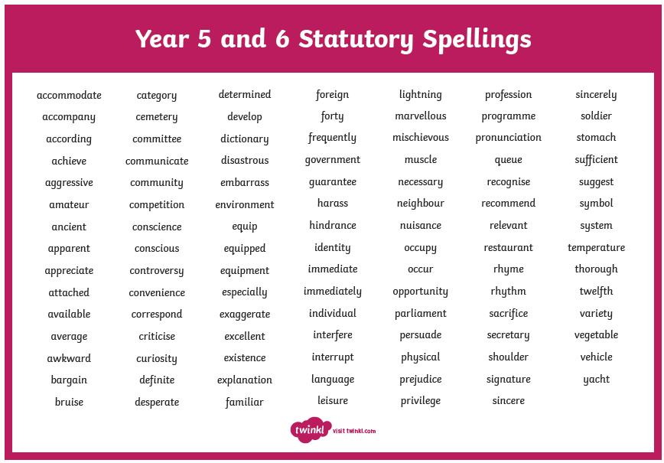

Slide 18
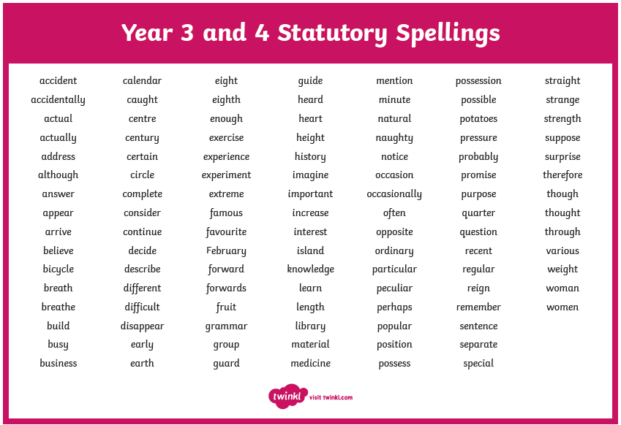

Slide 19
You can help at home with…
The wider curriculum
Discuss topics being studied with your child – ask them about their learning.
Supporting your child with researching on the internet or using books to find out more facts about a topic or subject.
Sharing your own passions, interests or skills with your child to enhance their learning.

Slide 20

Secondary Schools ​
You can find more information about applying for secondary schools online, you can click here to find out more:
Bristol City Council Secondary Information
You can apply online from 12th September
You must apply online by October 31st

Slide 21
Year 6 residential trip…
The Year 6 residential trip is in the process of being booked and information will be sent home shortly.
This will take place in the summer term.
There will be a parent meeting to discuss the trip and answer any of your questions and queries.

Slide 22
Home-school communication
We will use Class Dojo to keep you updated on what is happening in Year 6 and across the wider school.
Please allow notifications or check the app regularly.
We will always try to reply to your messages within 3 working days.

Slide 23
Over the course of the year if you have any questions, please send in an email to the office, send a message on ClassDojo or catch us after school one day!

